Slide 1
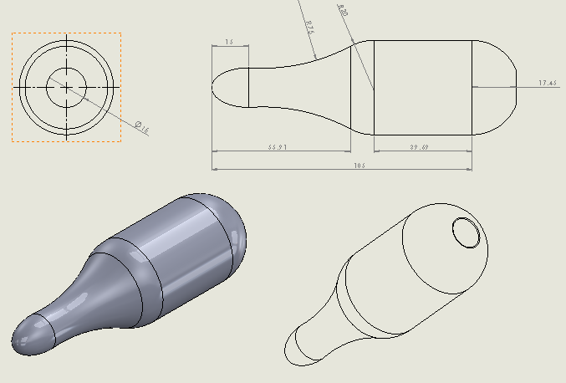
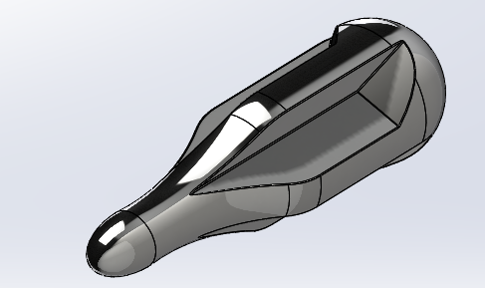
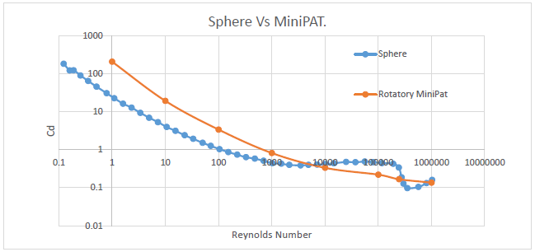
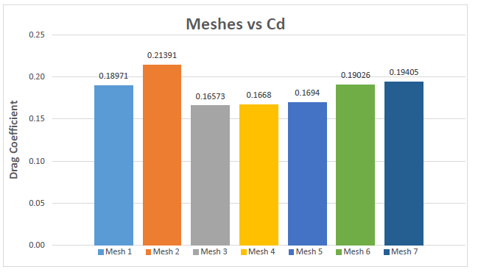
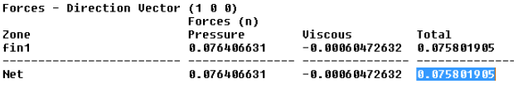

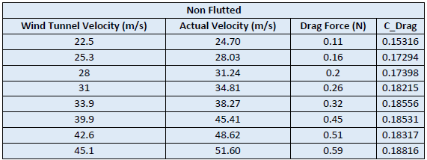
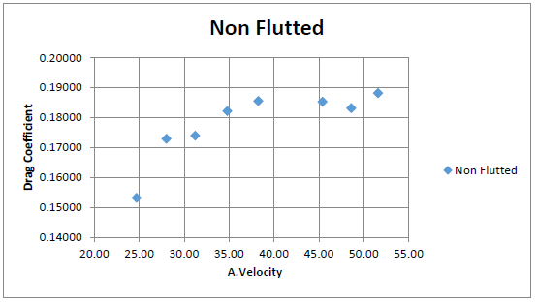
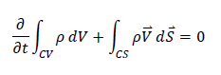
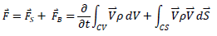
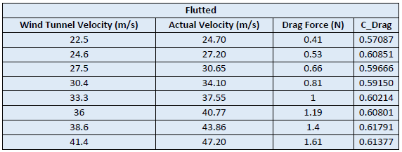
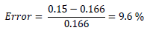
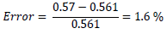
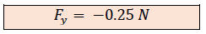
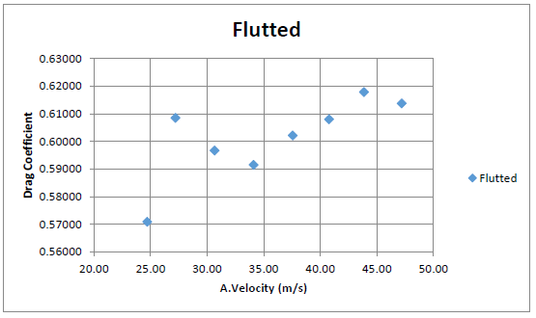

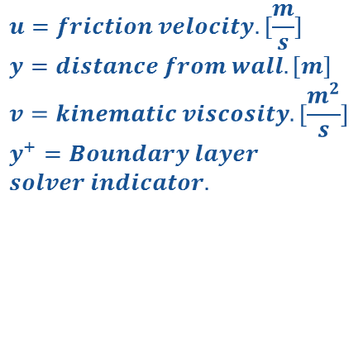
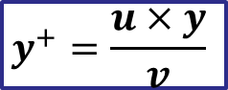
Development of a self-sustaining tracking sensor control for marine species. [Rotatory MiniPat]
Diego Ruiz Undergraduate Researcher
Seth Lawrence Graduate Research Assistant
Greg Hahn Graduate Research Assistant
Heather Kutz
Graduate Research Assistant
Dr. M. Shafer
Professor, Mechanical Engineering
Introduction
The studies of migratory movement of some marine species is currently being an important subject, these allow us to discover study’s movements, habitat utilization and post –release survival of pelagic animals. To accomplish this goal, many firms in this market have presented different systems and products. WILDLIFE COMPUTERS is a powerful company, which designs and develops these tracking sensors. For our case, let us focus on the MiniPAT- 348A. Sensor data are collected during deployment, and archived in onboard memory, finally the final data is uploaded to Argos satellites. Nevertheless, the main issue of this sensor is its operating life time, which is about 2 years. Therefore, our mission is to improve the operating life, reaching the self-supply of the whole system and avoiding replacing batteries, a good idea for it, it is the use of renewable energy systems. In order to keep the battery charged, it needs to be developed an energy source. This project consists in a rotatory device, which is rotated by water going through. The rotational motion produce energy necessary to power the whole system. Our goals are to calculate the main parameters, which characterize this device by various means: Simulations, theoretic and experimental methods.
The final part of this project is the installation of a generator, battery and a sensor in the device. Let’s consider that improvement in the design are possible.
2. Methods
This project will consider various mechanisms with the aim to obtain results. The three main methods are simulations (Ansys Fluent), experiments and theoretical calculations. Noting that, we do not have any previous experiment or project, that we can use in order to match results, we will use these methods to verify that we are getting reliable data. In this project has been developed two different model, one which has been named as Non-Fluted MiniPat and the second one as Fluted MiniPat.
SIMULATIONS: For the Non-Fluted MiniPat, we have done seven different meshes from the lowest number of cells to the highest number of cells with the aim to find a good meshing method, taking into consideration all the meaningful aspect in a CFD problem. Once that we have obtained the right mesh, we have applied a similar mesh for the Fluted MiniPat design. In theses simulations we got the drag coefficient of both models and the torque of the Fluted one. The CFD program also allows us to obtain fluid visualizations.
EXPERIMENTS: We will test our models in the wind tunnel by rapid prototyping. One consideration to do in this part of the experiment is to be aware of matching the Reynolds number correctly because the fluid in our CFD is water and in the wind tunnel is air. By a forcemeter, it is possible to calculate the drag coefficient of both models. We have been able to visualize the stream lines next to the device’s surfaces by a smoke generator.
THEORETICAL CALCULATIONS: In this section we want to calculate the torque by the fluid conservation equations.
Illustration [1]. WILDLIFE COMPUTERS
Illustration [3]UNFLUTED DESIGN.
Illustration [2].
Illustration [4].FLUTED DESIGN
VISUALIZATION
3. Results: SIMULATIONS (ANSYS FLUENT)
Non-Fluted MiniPat
In the graph below, we can see seven different meshes. We have simulated seven meshes because we need to select the one which we think is the right one for our experiment. This method of comparing more than one simulation is called independent study. It has been chosen number four. the main reason why I have chosen the mesh number 4 is because the results of this mesh works in an order of magnitude good enough and the number of cells is accepted for our computer.
This equation has been applied with the aim to calculate the first wall distance ∆s. By a solver http://www.pointwise.com/yplus/. See below, how the first cell distance is in the same scale that ∆s.
Plot [2].
Illustration [9].
$$u=friction velocity. [\frac{m}{s}]$$
$$y=distance from wall. [m]$$
$$v=kinematic viscosity. [\frac{m^{2}}{s}]$$
$$y^{+}=Boundary layer$$
$$solver indicator.$$
Reynolds number of a sphere vs Cd in comparison with MiniPat.
See above, pressure at the wall, the pressure contours seem very good over the shape. The highest pressure point is found at the stagnation point.
$$y^{+}=\frac{u×y}{v}$$
Fluted MiniPat
Equation [1].
For this mesh, we have used the same techniques as the non-fluted model. These techniques do a good job at the most complex parts of the geometry as well as edges.
DRAG COEFFIENT
 | Non-Fluted MiniPat | Fluted MiniPat
Drag Coefficient | 0.1667 | 0.561
TORQUE
Table [1].
Plot [1].
We are going to calculate the force at one of the four surface which produces torque respect to the devices axis and multiply it by four. (four surfaces).
Illustration [5].
Illustration [6].
Illustration [7].
Illustration [8].
Illustration [10].
Illustration [11].
4. Results: EXPERIMETS
5. Results:
THEORETICAL CALCULATIONS
In this section we want to calculate the torque by the fluid conservation equations.
6. Conclusions
In this section, it is going to be presented the experimental methods of this project. This part of the project is going to be vital to match our results from Fluent and ensure that our simulation is right as well.
To achieve this goal, we need to know the velocity of the fluid through the shape in the wind tunnel.
If we are not able to have reference values, we will be obligated to develop an independent study as we have done which might be complex. After our independent study, we could match the drag coefficient with the experimental results from the wind tunnel.
To calculate the angular speed and torque, we might test it in different ways:
We can install the rotatory MiniPat at the wind tunnel with a couple of bearings and with an electric motor which is going to be rotated by the MiniPat. So, the angular speed can be calculated by strobe light and we can obtain the generated power produce by the MiniPat. The torque is going to be a result of dividing the power by the angular speed.
We can also test the MiniPat in a transparent water tank. The idea for this experiment is leave the MiniPat from the top of the tank to the bottom. Using the water parameter, how long it takes the MiniPat to get the bottom and how many revolutions the MiniPat does, torque can be calculated.
I would like to comment how we can improve the design of the model. In the visualization of the streamlines we can observe how the streamlines abruptly interact with the freestream fluid at the outlet of the MiniPat. To make this interaction smoother we can design the outlet of the MiniPat with the aim to exhaust the fluid right after the outlet instead of the lateral of the MiniPat.
Illustration [12].
Table [2].
Assumptions:
Incompressible flow. (Water)
Uniform flow at each section.
𝜔 = constant.
Steady flow
𝐴1 = 𝐴6 and 𝐴2, 𝐴3, 𝐴4 , 𝐴5 → 𝑣 = 0,
𝑛𝑜 𝑠𝑙𝑖𝑝 𝑐𝑜𝑛𝑑𝑖𝑡𝑖𝑜𝑛.
For this, we are using dimensional analysis method, by the Reynolds number we can find a proper velocity in the wind tunnel. Nevertheless, before calculating the Reynolds number, we need to calculate some parameters in the wind tunnel because we are running our experiments in Flagstaff, son we need to calculate the density, dynamic viscosity and corrected velocity in Flagstaff. In the illustrations [13], it can see where the device is placed in the wind tunnel and the interface as well. In the tables and plots of the left side we have launched experiments at different air speeds. The result that we take is Cd = 0.15 for Non-Fluted and Cd = 0.57 for Fluted.
Equation [2].
Equation [3].
See below error between CFD and experiments:
Plot [3].
Non-Fluted MiniPat Error:
Illustration [14].
Fluted MiniPat Error:
Table [3].
References :
1. J. Pritchard. “Fox and McDonald’s introduction to Fluid Mechanics”, 8th edition, 2011.
2. John Anderson Jr. “Fundamentals of Aerodynamics”, 5th edition, 2010.
3. John Anderson Jr. “Computational Fluid Dynamics. The basic with applications”, 1st edition,1995.
4. Ansys, Customer Training Material.”Introduction to ANSYS Workshop”, 2010.
5. Ansys, Customer Training Material.”Introduction to ANSYS FLUENT”, 2010.
6. AeroLab Handouts, ”Manuel of AeroLab”
7. Wildlife Computers,” ProductSheet_MiniPAT_v15-10”, 2014.
8. "Test by Yachting Monthly: "Highest Top Speed..."" Folding Propellers. N.p., n.d. Web. 10 May 2016.
9. NASA. NASA, n.d. Web. 10 May 2016.
10. "CFD Online." CFD Online. N.p., n.d. Web. 10 May 2016
11. "Local Weather Conditions - Northern Arizona University, Flagstaff, Arizona."Local Weather
Acknowledgments:
Special thanks to the Dr. Thomas Acker, Dr. Michael Shafer, Seth Lawrence and Greg Hahm .
This is a fluid-mechanics problem, which has been solved by conservation equation of mass and conservation of momentum. The given inlet area is calculated by SolidWorks and the radio respect the axis where the force produces torque is the center of pressure of the inlet area, for this case we have estimated it, since is not going to make a big difference. Let’s compare the CFD result (5.8 N mm) with the theoretical problem (19 N mm) the error between them is quite high however both are in a similar rage of magnitude.
Illustration [13].
Plot [4].

